Slide 1

THE SUCCESS OF Hotel
DATA MINING AND MACHINE LEARNING
FINAL PROJECT
Ofir Bitan and Gali Seregin

Slide 2

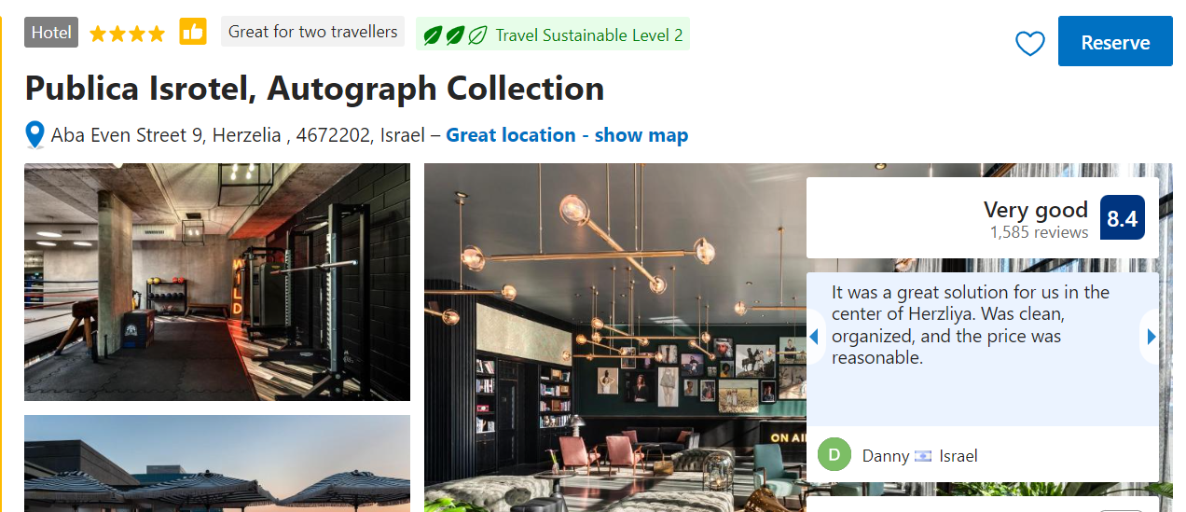
Agenda
Our research question
About us
We decided to check whether it is possible to predict whether a hotel will succeed ( get a high rating by the booking website) given Analysis of parameters from the booking.com based on hotels with similar characteristics.
Example of parameters: city name, distance from the city center.
We are two good friends who really like to travel. When we chose hotels, we knew that we could always rely on the opinions of previous visitors to choose the best hotel for us. Like us, many people use feedback, which can affect the success or lack of success of a hotel.
For example: if I arrive at a hotel and receive good service, I will leave positive feedback when a traveler sees my feedback along with options that the hotel offers, he can decide whether it is worth investing his money in a room in this hotel

Slide 3

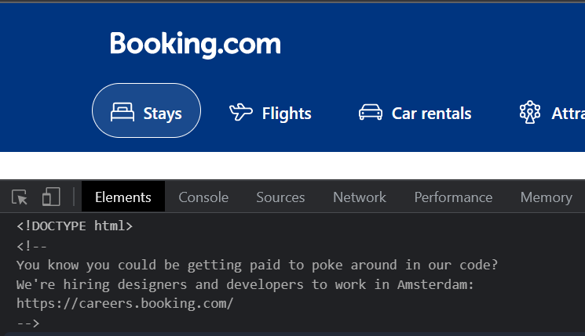

Data-Acquisition
Web crawling
And we started scraping
But booking is smarter

Slide 4
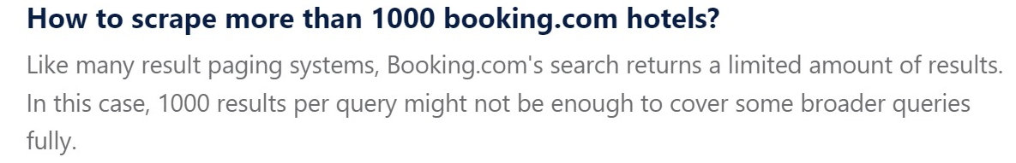

We found that booking is protected site that don’t share its information easily.
So, we started looking for another option.
We found a great website that allows us to get its information.

Slide 5

Data acquisition

Slide 6

Data acquisition
Crawling – using ‘Beautiful Soup’ library we performed the crawling stage.
Hotels– we saved URLS to relevant all the relevant data we needed in csv file.
The complete list:
Hotel name , Hotel URL , Number of reviews , TripAdvisor rating , Rating regarding other hotels in the same city , Location rating , Cleanliness rating , Service rating , Value of money , Paid private parking nearby , Free high-speed Wi-Fi , Fitness center , Air conditioning , Minibar , Cable satellite TV , 24-hour front desk , Non-smoking hotel , Express check-in, check-out , Baggage storage , Housekeeping , Safe , Family rooms .

Slide 7

Crawling
In-order to get all the data we needed, we had to write a function to crawl and save all the relevant data.
The function works as follows:
The function gets number of pages we want do dig in (in specific city)
From the inspect we get string that contains the next page URI
We try to get to this page :
In case of success, we go to next page
Otherwise there no more pages and we finish

Slide 8
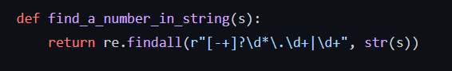
Getting numbers
In some cases, we needed numeric answers (for example the TripAdvisor grades) for that we used our knowledge from 10th lesson and build a function that helps as to do so.
This function appears to use a regular expression to find all numeric values in a string. The regular expression looks for:
Optional leading plus or minus sign (indicated by [-+]?)
Optionally, any number of digits (indicated by \d*)
A literal period (indicated by \.)
At least one digit (indicated by \d+)

Slide 9

Getting numbers
This pattern will match floating point numbers like 3.14, -2.718, and +4.0. Alternatively, the pattern will match integers if there is no period present, such as 42, -13, or +0.
The function then uses the re module's find all function to search the input string for all occurrences of this pattern and returns a list of the matching values. Regenerate response

Slide 10
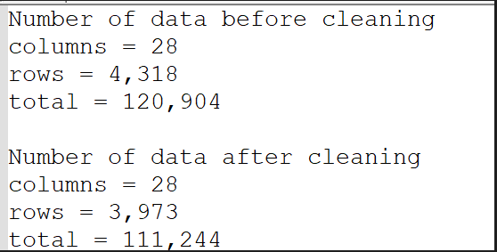

Data Cleaning

Slide 11

Data cleaning
After scraping all the genres and finishing the data acquisition phase, we had to clean our data, performing:
Concatenation of all the information into one table while adjusting the columns into a uniform format.
Remove duplicates while leaving only one copy.
Removing rows which do not have the data we need for our research question.
Removing corrupt rows containing too many empty values. (In our case, ‘too many’ equals 5)
Data Cleaning
Cleaning, formatting, and filtering the data.

Slide 12
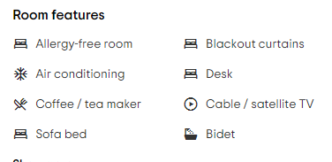
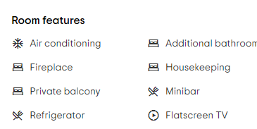
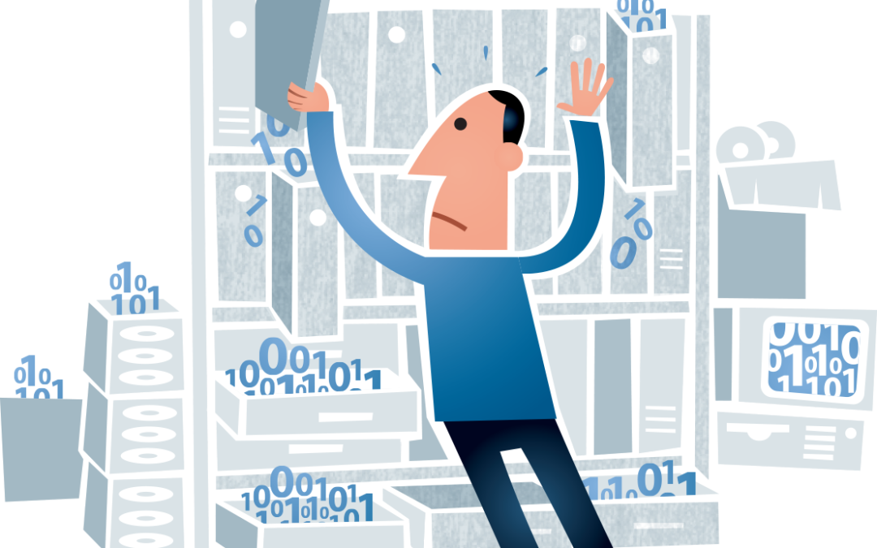
Hotel X:
Data cleaning- missing values
Getting the features:
In every hotel the Room features are not the same for example hotel x Bidet hotel Y don’t. when we scrapped the data, we got some errors because of the lack of uniformity in the features. In this case our solution was to get the information in Boolean data for example for hotel X we got 1 and for Y 0
Hotel Y:

Slide 13
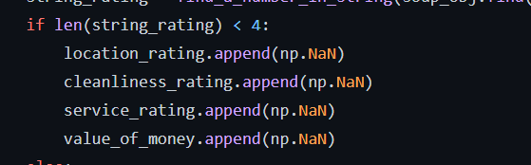
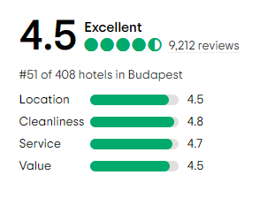
Data cleaning- missing values
We also had some missing parameters while collecting the grades of different categories, in some of the hotels we found that one or more category was missing so in this case we putted Nan in all the other parameters and while cleaning removed every line in the data frame that had at least one missing parameter.

Slide 14
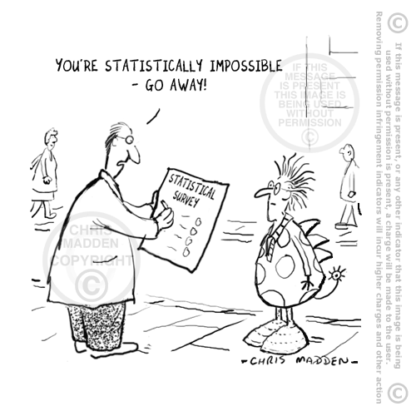
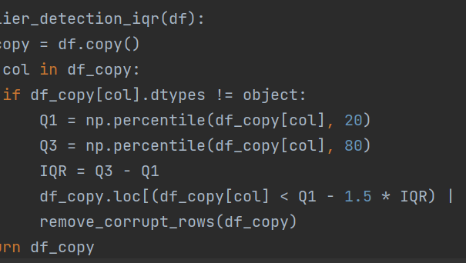
Data cleaning – outliers
After working on our data frame, we noticed that some of our data is invalid, grades not in range or which seems to0 low to actually be true. In-order to make our data more reliable, we used iqr function.
Notes:
לתקן

Slide 15
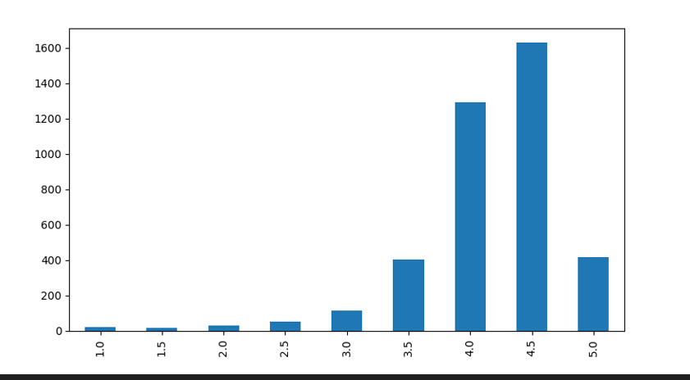
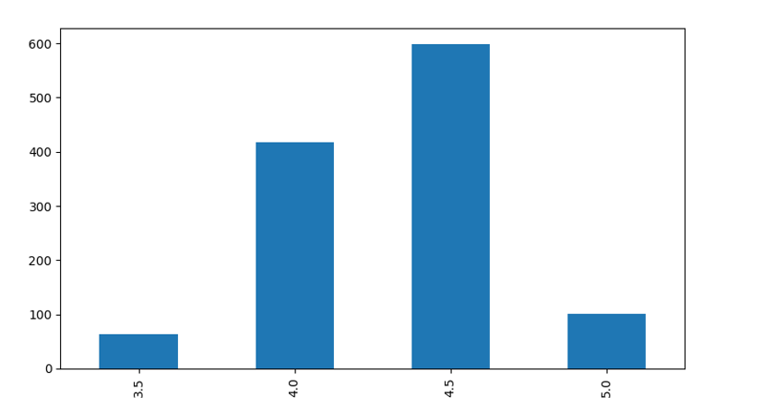
Normalized data
Like any business, our site also wants people to continue to make purchases on it, so you will thin out and remove hotels that are considered low quality. As you can see there are very few hotels with a rating lower than 3.5 because in order to be published there are requirements from the hotels. One of the things we did when we handled abnormal data was to remove those hotels that are candidates for removal from the site and are not relevant to us
Notes:
לתקן

Slide 16

EDA
Visualizing and understanding the data

Slide 17
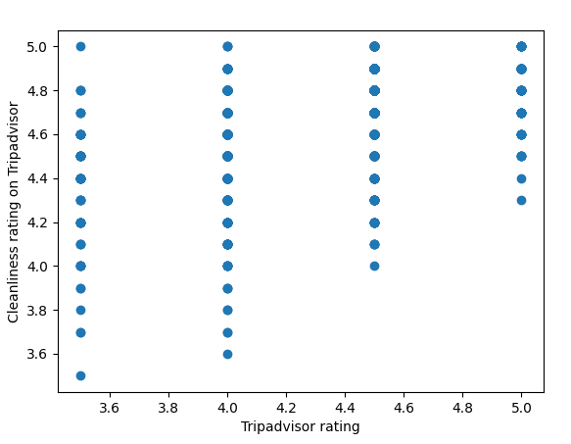
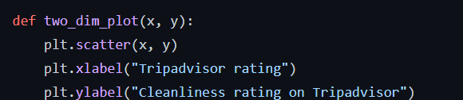
EDA – influence of cleaning on rating
In this diagram we can see the influence of cleaning service on the rating of our hotel on TripAdvisor . The higher the lowest score on cleanliness the higher is TripAdvisor rating.

Slide 18
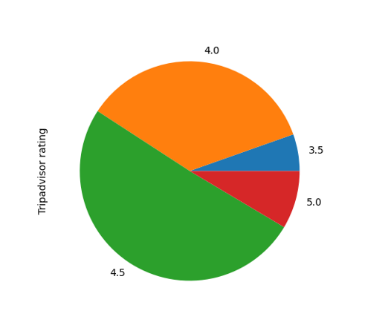
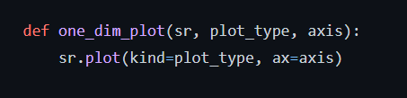
EDA – Hotels rating split
So.. What am I looking at?
A pie chart which was created using matplotlib.pyplot, showing us the partition of grades between different hotels in our data frame.

Slide 19
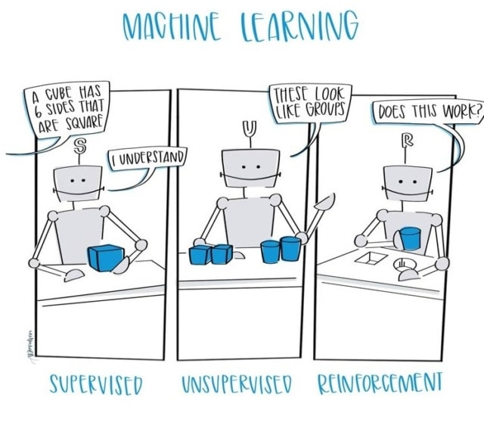
Machine Learning
Create final predict model
Machine Learning

Slide 20
Small intro
While scraping the data we just couldn't ignore the number of responses people write about their experience from the hotel, so we thought how to use them
We noticed that in every response people express feelings like "great" "good" or alternatively "disappointing" we realized that when they give their numerical rating, they don't always know how to define their feeling as a number for example man how was verry upset from the hotel gave the grade 4.0
So, we created dictionary of “good” and “bad” words and summed them .For every good case +1 , bad case -1 so if you see in our column grade under 0 maybe you should reserve room in other hotel .

Slide 21

Choosing predicting Algorithm
When we had to choose the right algorithm for our prediction, we immediately knew that we had to turn to supervised learning because all the categories in our case are known in advance (the distribution of grades)
But when we wanted to choose the right label, we encountered a dilemma.
On the one hand the numbers we work with are numbers between 1.0-5.0 but on the other hand the number 4.38 for example will not appear as an option and we have 40 categories
Therefore, we realized that we must go to the label of categorical numbers

Slide 22
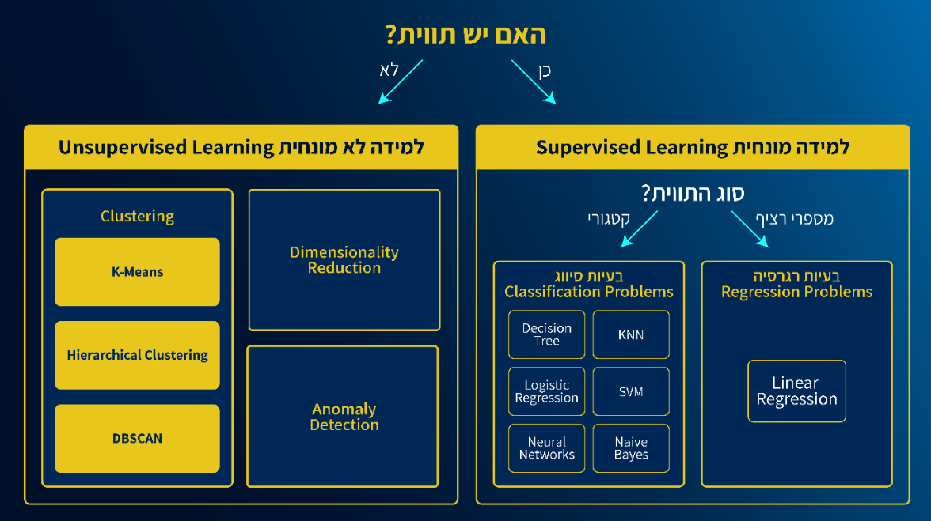


Slide 23

Predicting algorithms
In order to achieve the best result, we used 4 machine learning algorithms, and these are the results we received:

Slide 24

Choosing our algorithm
When choosing the best algorithms for as we wanted to try some options lets discus each of them and decide which one is better.

Slide 25
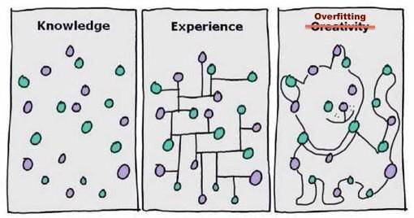
Small intro –overfitting defenition
Overfitting is a phenomenon that occurs when a machine learning model is trained on a dataset that is too small or too noisy, and it ends up performing poorly on unseen data. It happens because the model has learned patterns in the training data that do not generalize to new situations. This can lead to poor performance on the test set or in production.

Slide 26

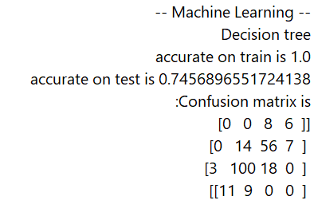
Decision tree
Decision trees are easy to understand and interpret, and they can handle high-dimensional data and missing values.
However, they can be prone to overfitting and may not always provide the best results.

Slide 27
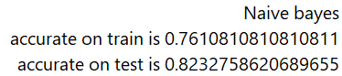

Naïve bayes
Naive Bayes is a simple, yet powerful probabilistic classifier based on the application of Bayes' theorem with strong (naive) independence assumptions between the features. It is a supervised learning algorithm used for classification tasks.
Naive Bayes is a fast, simple, and easy-to-implement algorithm that performs well on many classification tasks. It is especially well-suited for problems with many features or many classes.
One of its main limitations is that it assumes that all features are independent of each other, which is often not the case in real-world data. Despite this limitation, it often performs surprisingly well in practice.

Slide 28
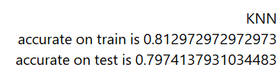
KNN
KNN is a simple but powerful algorithm that is often used as a baseline for more complex models. One of its main benefits is that it is easy to implement and understand, which makes it a good choice for prototyping and testing. However, it can be computationally expensive and may not perform well on large, high-dimensional datasets.

Slide 29
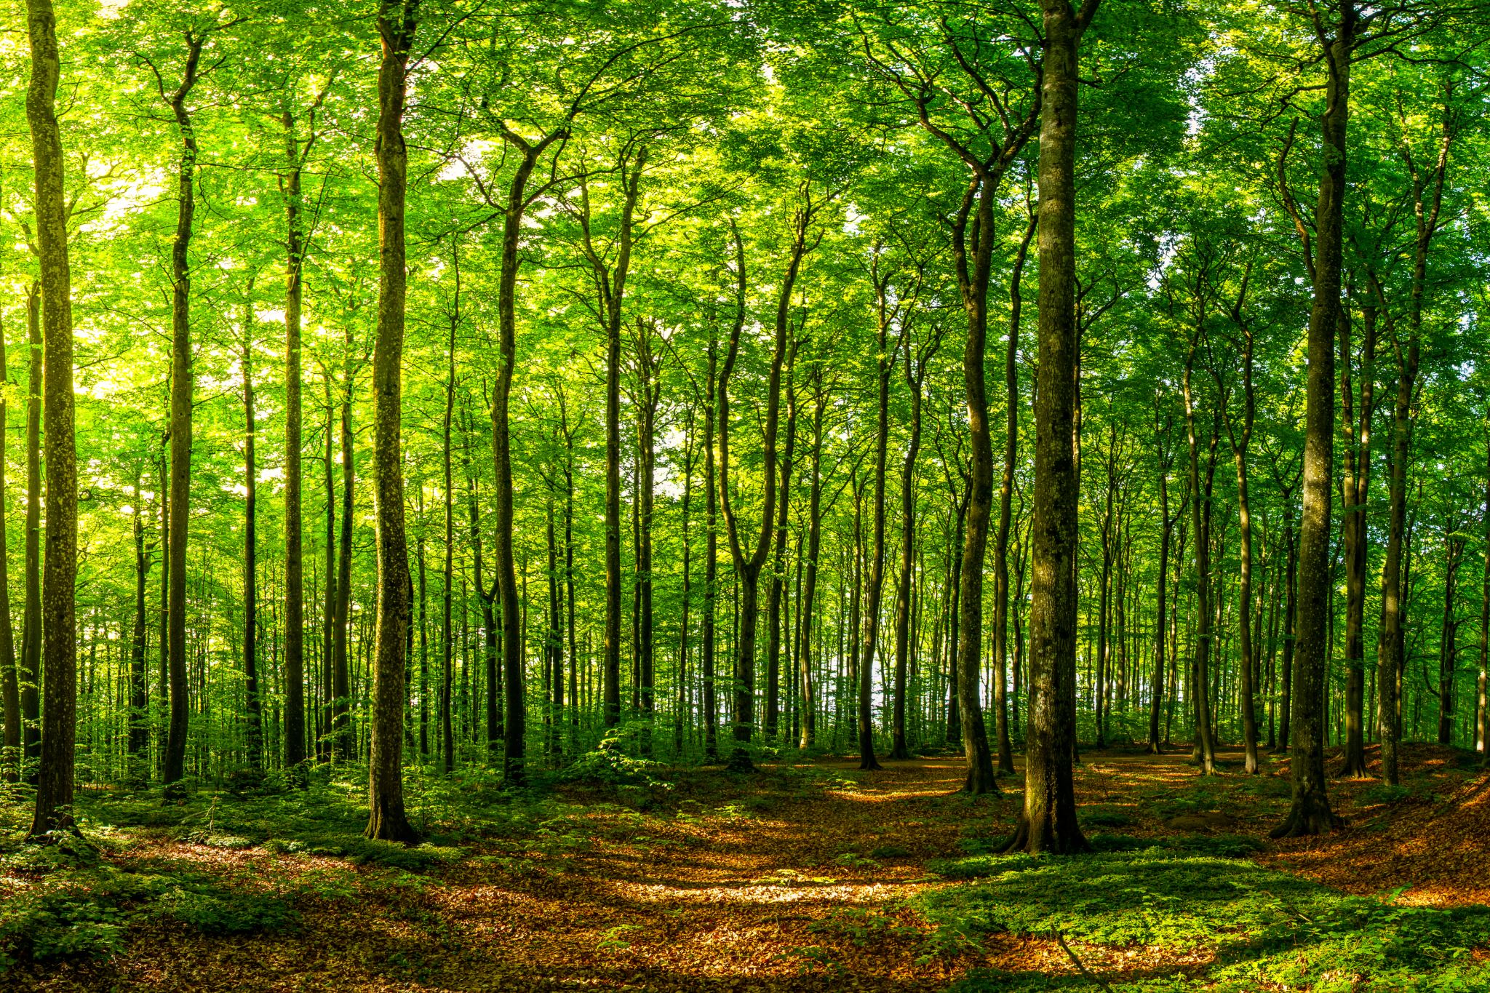
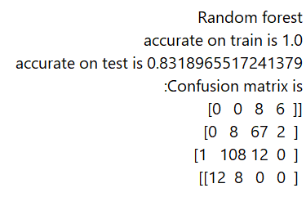
Random forest
Notes:
Random forest is an ensemble learning method for classification and regression that operates by constructing a multitude of decision trees at training time and outputting the class that is the mode of the classes (classification) or mean prediction (regression) of the individual trees. Random forests are a popular choice for building predictive models because they can handle high-dimensional data and are resistant to overfitting.
Here's a simple example of how random forests work:
Select a random sample of data from the training set.
Build a decision tree using the random sample.
Repeat steps 1 and 2 multiple times to build a forest of decision trees.
For a new, unseen data point, make a prediction by having each tree in the forest make a prediction and taking the average (for regression) or mode (for classification).
One of the main benefits of random forests is that they are very good at avoiding overfitting, which is a common problem in decision tree models. They also have the ability to handle high-dimensional data and missing values, and they can be used for both classification and regression tasks. However, they can be computationally expensive and may not be the best choice for problems with a large number of training examples or a large number of features.

Slide 30
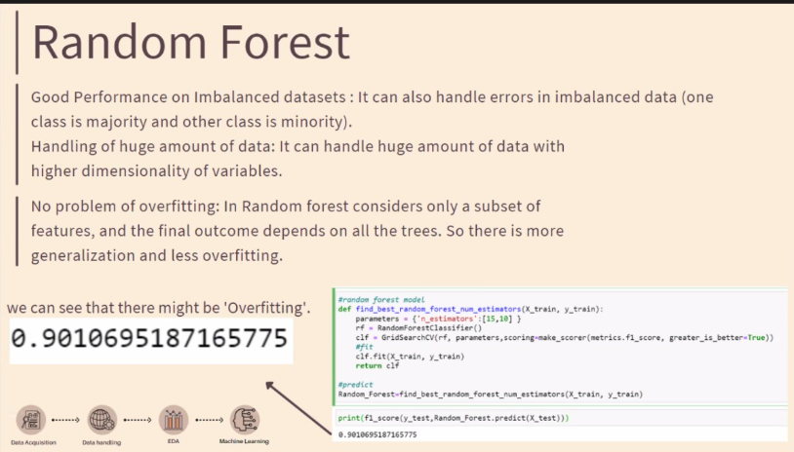

Slide 31
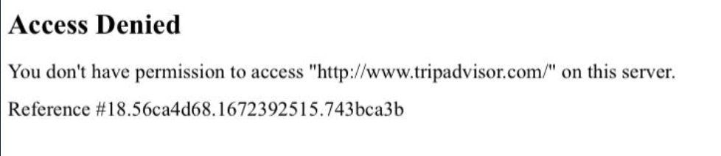

No more TripAdvisor for Ofir
Because we wanted to get a lot of data the process of loading took a lot of time, so we decided to leave the code running during the night. In the morning we saw that the site blocked our computer so if we wants to get in, we getting an error, but even though we still can run our code and get data from the site

Slide 32


Thank you

